Slide 1
Postgres Conference Silicon Valley 2022 San Jose / United Statues April 07-08, 2022
Tune PostgreSQL for Read/Write Scalability.
Technical Breakout
Ibrar Ahmed
Senior Database Architect
Percona LLC

Slide 2
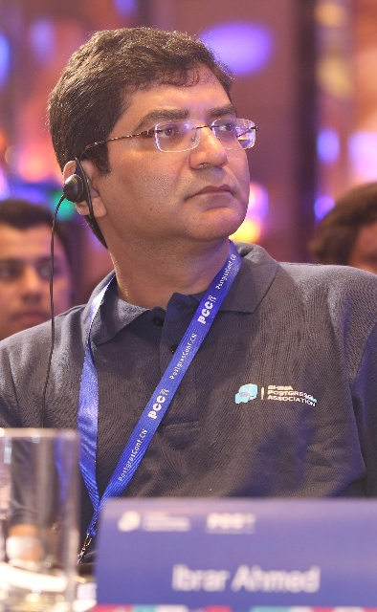
Who am I?
Software Career
Software industries since 1998.
PostgreSQL Career
Working on PostgreSQL Since 2006.
EnterpriseDB (Associate Software Architect core Database Engine) 2006-2009
EnterpriseDB (Software Architect core Database Engine) 2011 - 2016
EnterpriseDB (Senior Software Architect core Database Engine) 2016 – 2018
Percona (Senior Software Architect core Database Engine) 2018 – Present
@ibrar_ahmad
IBRAR AHMED
Senior Software Architect
https://www.facebook.com/ibrar.ahmed
Percona LLC
PostgreSQL Books
https://www.linkedin.com/in/ibrarahmed74/
PostgreSQL Developer's Guide
PostgreSQL 9.6 High Performance

Slide 3
Database Performance
Database Performance
PostgreSQL Architecture
PostgreSQL Performance Tuning
Key Factors about Database Performance
PostgreSQL Modules
Tune your PostgreSQL Box
Database Benchmarking
Linux Kernel Tuning
Benchmark your database
Tune you Linux Box

Slide 4

02
Database Performance

Slide 5


Database Performance
Hardware
Operating System
Software
Choose your hardware wisely
Operating System Selection and Tuning
Software Impact on database performance
Workload
Database
Choose Database according to your workload
Choose your database according your data need

Slide 6
Software
Software Type
Impact of badly written and well-defined software
Queries
Impact of Database Queries on the database
Connectors
Choose your connector wisely

Slide 7
Hardware
Processor
CPU performance and number of processor cores
Memory
Memory requirement for your workload
Disk
Disk speed and size
Network
Network latency

Slide 8
Operating System
Environment
Operating system environment according to your database and application
Compatibility
Operating system compatibility with your database and application
Performance
Operating system performance which suites your database
Support
How good is your support for operating system

Slide 9
Workload
SQL / NOSQL
Is your workload best suited for SQL or NOSQL?
Size of Workload
Size of workload is important for tunning
OLTP / OLAP
Type of workload, is it OLAP or OLTP
Read / Write Intensive
Is your workload Read or Write intensive?

Slide 10
Database

Slide 11
02
PostgreSQL Architecture

Slide 12

PostgreSQL Architecture
Archiver process
Logging Collector
Auto VACUUM
WAL Writter
Bg Writters
Checkpointer
Stat collector
Postmaster
Data Files (table space)
Data Files ($PGDATA)
13007/12831
13007/12833
13007/12832
12832
12832
Postgres
Postgres
Postgres
WAL Files (pg_wal)
000000010000000000000085
000000010000000000000090
00000001000000000000009B
Shared_buffers
WAL Buffers
CLOG buffers
Temp Buffers
Log Files
Buffers

Slide 13
02
PostgreSQL Performance Tuning

Slide 14
Database Performance
Tunning Parameter
PostgreSQL Indexes
Query Analysis
PostgreSQL Tunning Parameters
Impact of index on Database Performance
Analyze your queries for optimal database performance
Partitioning
Monitoring
Partition your database when require
Monitor your database to identify the bottleneck

Slide 15
Tunning Parameters
Memory based configuration parameters
shared_buffers
02
wal_buffers
03
effective_cache_size
1
PostgreSQL Memory buffer
Buffer for WAL
PostgreSQL Cache
04
work_mem
05
maintenance_work_mem
06
Other
Buffer for sorting
Buffer for Maintenance activity
postgresql.conf file contains all the parameters

Slide 16

shared_buffers
PostgreSQL uses its own buffer along with kernel buffered I/O.
PostgreSQL does not change the information on disk directly then how?
Writes the data to shared buffer cache.
The backend process write that these blocks kernel buffer.
postgresql=# SHOW shared_buffers;
shared_buffers
----------------
128MB
(1 row)
The proper size for the POSTGRESQL shared buffer cache is the largest useful size that does not adversely affect other activity.
—Bruce Momjian

Slide 17
wal_buffer
Do you have Transaction? Obviously
WAL – (Write Ahead LOG) Log your transactions
Size of WAL files 16MB with 8K Block size (can be changed at compile time)
PostgreSQL writes WAL into the buffers(wal_buffer ) and then these buffers are flushed to disk.
Bigger value for wal_buffer in case of lot of concurrent connection gives better performance.

Slide 18
effective_cache_size
This used by the optimizer to estimate the size of the kernel's disk buffer cache.
The effective_cache_size provides an estimate of the memory available for disk caching.
It is just a guideline, not the exact allocated memory or cache size.

Slide 19
work_mem
This configuration is used for complex sorting.
It allows PostgreSQL to do larger in-memory sorts.
Each value is per session based, that means if you set that value to 10MB and 10 users issue sort queries then 100MB will be allocated.
In case of merge sort, if x number of tables are involved in the sort then x * work_mem will be used.
It will allocate when required.
Line in EXPLAIN ANALYZE “Sort Method: external merge Disk: 70208kB”

Slide 20

work_mem
postgres=# SET work_mem ='2MB';
postgres=# EXPLAIN ANALYZE SELECT * FROM foo ORDER BY id;
QUERY PLAN
-------------------------------------------------------------------------------------------------------------
Gather Merge (cost=848382.53..1917901.57 rows=9166666 width=9) (actual time=5646.575..12567.495 rows=11000000 loops=1)
-> Sort (cost=847382.51..858840.84 rows=4583333 width=9) (actual time=5568.049..7110.789 rows=3666667 loops=3)
Planning Time: 0.055 ms
Execution Time: 13724.353 ms
postgres=# SET work_mem ='1GB';
postgres=# EXPLAIN ANALYZE SELECT * FROM foo ORDER BY id;
QUERY PLAN
-------------------------------------------------------------------------------------------------------------
Sort (cost=1455965.01..1483465.01 rows=11000000 width=9) (actual time=5346.423..6554.609 rows=11000000 loops=1)
Sort Key: id
Sort Method: quicksort Memory: 916136kB
-> Seq Scan on foo (cost=0.00..169460.00 rows=11000000 width=9) (actual time=0.011..1794.912 rows=11000000 loops=1)
Planning Time: 0.049 ms
Execution Time: 7756.950 ms

Slide 21
maintenance_work_mem
maintenance_work_mem is a memory setting used for maintenance tasks.
The default value is 64MB.
Setting a large value helps in tasks like
VACUUM
RESTORE
CREATE INDEX
ADD FOREIGN KEY
ALTER TABLE.

Slide 22
maintenance_work_mem
CHECKPOINT;
SET maintenance_work_mem='10MB';
SHOW maintenance_work_mem;
maintenance_work_mem
----------------------
10MB
(1 row)
postgres=# CREATE INDEX idx_foo ON foo(id);
Time: 12374.931 ms (00:12.375)
CHECKPOINT;
SET maintenance_work_mem='1GB';
SHOW maintenance_work_mem;
maintenance_work_mem
----------------------
1GB
(1 row)
postgres=# CREATE INDEX idx_foo ON foo(id);
Time: 9550.766 ms (00:09.551)

Slide 23
synchronous_commit
This is used to enforce that commit will wait for WAL to be written on disk before returning a success status to the client.
This is a trade-off between performance and reliability.
Increasing reliability decreases performance and vice versa.
Synchronous commit doesn't introduce the risk of corruption, which is really bad, just some risk of data loss.
https://wiki.postgresql.org/wiki/Tuning_Your_PostgreSQL_Server

Slide 24
Tunning Parameters
I/O based configuration parameters
checkpoint_completion_target
checkpoint_timeout
03
max_wal_size
05
01
Time for checkpoint
Max WAL size
Checkpoint completion target

Slide 25
checkpoint_timeout
PostgreSQL writes changes into WAL. The checkpoint process flushes the data into the data files.
More checkpoints have a negative impact on performance.
Frequent checkpoint reduce the recovery time

Slide 26
checkpoint_completion_target
Specifies the target of checkpoint completion, as a fraction of total time between checkpoints.
This parameter can only be set in the postgresql.conf file or on the server command line

Slide 27
max_wal_size
Maximum size to let the WAL grow during automatic checkpoints.
This is a soft limit; WAL size can exceed max_wal_size under special circumstances.
This parameter can only be set in the postgresql.conf file or on the server command line.

Slide 28
02
PostgreSQL Indexes

Slide 29
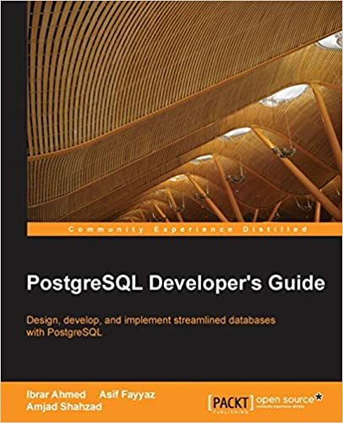
Heap / Index

Slide 30
PostgreSQL Indexes
B-Tree
Hash
Brin
PostgreSQL default index Based on B-Tree
PostgreSQL Index Method Based on Hasing
Block Range Index
GIST
GIN
Generalized Search Tree
Generalized Inverted Index

Slide 31
Sequential Scan
SELECT * FROM admin WHERE dt < '2021/04/01';
id | name | dt
-----+-------------+------------
3 | James | 2020-01-01
1 | Alex Johns | 2020-01-02
7 | Bob William | 2020-01-04
8 | Charli | 2020-01-01
6 | David | 2020-08-02
9 | Benjamin | 1990-01-02
SELECT ctid, * FROM admin WHERE id = 8;
ctid | id | name
-------+----+------
(1,0) | 16 | Charli
(1 rows)
pd_lsn
pd_checksum
pd_flags
pd_lower
pd_upper
pd_lsn
pd_checksum
pd_flags
pd_lower
pd_upper
pd_special
pd_pagesize_version
pd_prune_xid
1
2
3
pd_special
pd_pagesize_version
pd_prune_xid
1
2
3
Block 0
Line pointers
Line pointers
Block 1
Tuple 2
Tuple 2
7
Bob William
01/04/2020
1
Benjamin
01/02/1990
1
Alex John
01/02/2020
3
James
01/01/2020
8
Charli
01/01/2020
6
David
01/08/2020
Page size 8192 Bytes
Page size 8192 Bytes

Slide 32
B-Tree Index
SELECT id, name FROM admin WHERE id = 8;
id | name
-----+------
8 | Charli
(1 rows)
9
36
69
9
16
32
36
53
58
69
74
100
8
9
16
19
32
347
36
39
53
54
58
60
69
70
74
75
100
105
(1,1)
0
(1,2)
(1,3)
(1,2)
(1,8)
(2,1)
(2,2)
(2,8)
(3,1)
(3,2)
(4,1)
(4,3)
(4,7)
(4,8)
(5,1)
(5,2)
(7,2)
ctid
pd_lsn
pd_checksum
pd_flags
pd_lower
pd_upper
pd_lsn
pd_checksum
pd_flags
pd_lower
pd_upper
pd_special
pd_pagesize_version
pd_prune_xid
1
2
3
pd_special
pd_pagesize_version
pd_prune_xid
1
2
3
Block 0
Line pointers
Line pointers
Block 1
Tuple 2
Tuple 2
7
Bob William
01/04/2020
1
Benjamin
01/02/1990
1
Alex John
01/02/2020
3
James
01/01/2020
8
Charli
01/01/2020
6
David
01/08/2020
Page size 8192 Bytes
Page size 8192 Bytes

Slide 33
Hash Index
SELECT id, name FROM admin WHERE name LIKE ‘Alex Johns’;
id | name
-----+------
16 | Alex Johns
(1 rows)
Alex Johns
0000
0,0
James
0010
0,1
Bob William
Fh(x)
0011
0,2
Charli
0100
1,0
CTID
David
0101
1,1
Benjamin
0111
1,2
pd_lsn
pd_checksum
pd_flags
pd_lower
pd_upper
pd_lsn
pd_checksum
pd_flags
pd_lower
pd_upper
pd_special
pd_pagesize_version
pd_prune_xid
1
2
3
pd_special
pd_pagesize_version
pd_prune_xid
1
2
3
Block 0
Line pointers
Line pointers
Block 1
Tuple 2
Tuple 2
7
Bob William
01/04/2020
1
Benjamin
01/02/1990
1
Alex John
01/02/2020
3
James
01/01/2020
8
Charli
01/01/2020
6
David
01/08/2020
Page size 8192 Bytes
Page size 8192 Bytes

Slide 34
02
Linux Tuning for PostgreSQL

Slide 35
Linux Tunning
Memory Architecture
Huge Pages
Transparent Huge Pages
How to create indexes in PostgreSQL
Linux Huge pages
Linux Transparent Huge Pages
Tunning Parameters
Monitoring
Tune your Linux Box
Monitor your Linux OS

Slide 36
Input Output Handling
Direct IO, Buffered IO and Double buffering
PostgreSQL believes that the Operating system (Kernel) knows much better about storage and IO scheduling.
PostgreSQL has its own buffering; and also needs the pages cache. Double Buffering
It Increase the use of memory.
And different kernel and setting behave differently.

Slide 37
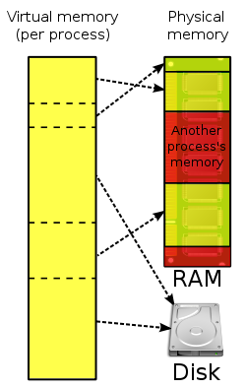
Virtual Memory
Every process is given the impression that it is working with large, contiguous sections of memory
Each process runs in its own dedicated address space
Pages Table are used to translate the virtual addresses seen by the application into Physical Address
https://en.wikipedia.org/wiki/Virtual_memory
https://en.wikipedia.org/wiki/Page_table

Slide 38
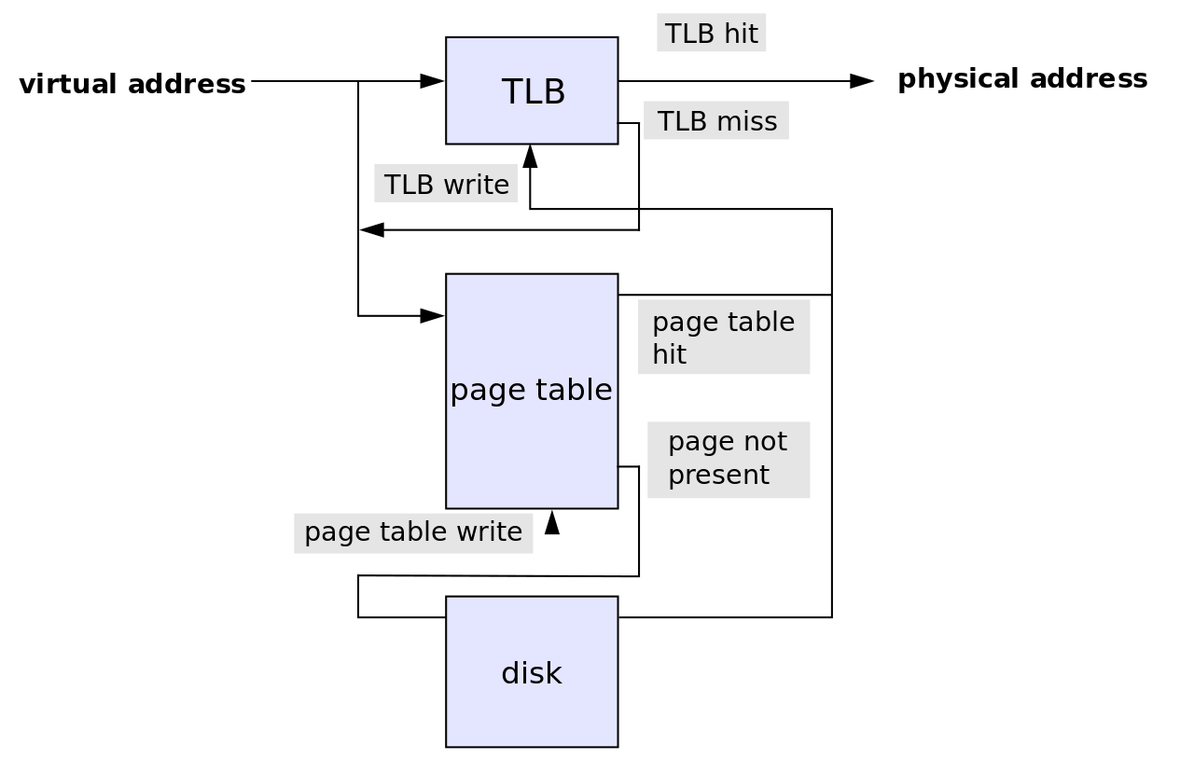
Translation Lookaside Buffer (TLB)
Translation Lookaside Buffer is a memory cache
It reduce the time to access a user memory location
If a match is found the physical address of the page is returned → TLB hit
If match not found scan the page table (walk)
looking for the address mapping (entry) → TLB miss
Small page size bigger TLB size → expensive

Slide 39
Memory Pages
PostgreSQL uses its own buffer along with kernel buffered I/O.
PostgreSQL does not change the information on disk directly then how?
Writes the data to shared buffer cache.
The backend process write that these blocks kernel buffer.

Slide 40
Linux Page sizes
Linux Page size is 4K
Many modern processors support other page sizes
If we consider a server with 256G of RAM:
4K | 67108864
2M | 131072
1G | 256
large/huge pages
Notes:
The address translation logic is also known as page table walking
The page table walk is expensive because it may require multiple memory accesses
Using large pages to improve the effectiveness of the TLB
by increasing the page size we'll have less pages to map

Slide 41
Classic Huge Pages
# cat /proc/meminfo
MemTotal: 264041660 kB
...
Hugepagesize: 2048 kB
DirectMap4k: 128116 kB
DirectMap2M: 3956736 kB
DirectMap1G: 266338304 kB
sysctl -w vm.nr_hugepages=256
Notes:
"Default" huge page size
DirectMap here is related to TLB use, I'm unsure if accurate though

Slide 42
Tunning Parameters
03
05
Classic Huge Pages
Tranparent Huge Pages
swappines
1
02
overcommit_memory & overcommit_ratio
04
dirty_background_ratio & dirty_background_bytes
06
vm.dirty_ratio & vm.dirty_bytes

Slide 43
Classic Huge Pages
# vi /etc/default/grub
GRUB_CMDLINE_LINUX_DEFAULT="hugepagesz=1GB default_hugepagesz=1G”
# update-grub
Generating grub configuration file ...
Found linux image: /boot/vmlinuz-4.4.0-75-generic
Found initrd image: /boot/initrd.img-4.4.0-75-generic
Found memtest86+ image: /memtest86+.elf
Found memtest86+ image: /memtest86+.bin
Done
# shutdown -r now
Notes:
huge page size can only be changed at boot time

Slide 44
Classic Huge Pages
# vim /etc/postgresql/10/main/postgresql.conf
huge_pages=ON # default is try
# service postgresql restart

Slide 45
Transparent Huge pages
The kernel works in the background (khugepaged) trying to:
"create" huge pages.
Find enough contiguous blocks of memory
Convert them into a huge page
Transparently allocate them to processes when there is a "fit"
Notes:
Transparent Hugepage Support is an alternative means of using huge pages for the backing of virtual memory with huge pages that supports the automatic promotion and demotion of page sizes

Slide 46
Disabling Transparent Huge pages
# cat /proc/meminfo | grep AnonHuge
AnonHugePages: 2048 kB
# ps aux | grep huge
root 42 0.0 0.0 0 0 ? SN Jan17 0:00 [khugepaged]
To disable it:
at runtime:
# echo never > /sys/kernel/mm/transparent_hugepage/enabled
# echo never > /sys/kernel/mm/transparent_hugepage/defrag
at boot time:
GRUB_CMDLINE_LINUX_DEFAULT="(...) transparent_hugepage=never"

Slide 47
vm.swappines
This is another kernel parameter that can affect the performance of the database.
Used to control the swappiness (swapping pages to swap memory into RAM) behavior on a Linux system.
The parameter can take anything from “0” to “100”.
The default value is 60.
Higher value means more aggressively swap.

Slide 48
vm.overcommit_memory and vm.overcommit_ratio
Applications acquire memory and free that memory when it is no longer needed.
But in some cases, an application acquires too much memory and does not release it. This can invoke the OOM killer.
This is used to control the memory over-commit.
It has three options
Heuristic overcommit, Do it intelligently (default); based kernel heuristics
Allow overcommit anyway
Don’t over commit beyond the overcommit ratio.

Slide 49
vm.dirty_background_ratio and vm.dirty_background_bytes
The vm.dirty_background_ratio is the percentage of memory filled with dirty pages that need to be flushed to disk.
Flushing is done in the background.
The value of this parameter ranges from 0 to 100;

Slide 50
vm.dirty_ratio / vm.dirty_bytes
The vm.dirty_background_ratio is the percentage of memory filled with dirty pages that need to be flushed to disk.
Flushing is done in the foreground.
The value of this parameter ranges from 0 to 100;

Slide 51
Blogs
Tuning PostgreSQL Database Parameters to Optimize Performance.
https://www.percona.com/blog/2018/08/31/tuning-postgresql-database-parameters-to-optimize-performance/
Tune Linux Kernel Parameters For PostgreSQL Optimization
https://www.percona.com/blog/2018/08/29/tune-linux-kernel-parameters-for-postgresql-optimization/

Slide 52
THANK YOU
GET IN TOUCH
@ibrar_ahmad
https://www.facebook.com/ibrar.ahmed
https://www.linkedin.com/in/ibrarahmed74/
www.pgelephant.com

